Slide 1
COMP6236
Software Engineering and Cyber Security
CORAS Exercise
Dr Mu Yang

Slide 2
Exercise
Create a group of 4-5 students (5 min)
Apply CORAS steps 3, 4, 5, 6,7,8
  Apply each step to the application scenario (35 min)
  Exchange results with the group next to you (5 min)

Slide 3
The scenario: Going on holiday
Leave the key of the house to a trusted neighbour
Leave a copy of the key of the house to the daughter
No pets, no intrusion alarm
Printed Documents ( passport, credit cards …) are kept in a locker
Scanned documents are saved on the personal computer

Slide 4
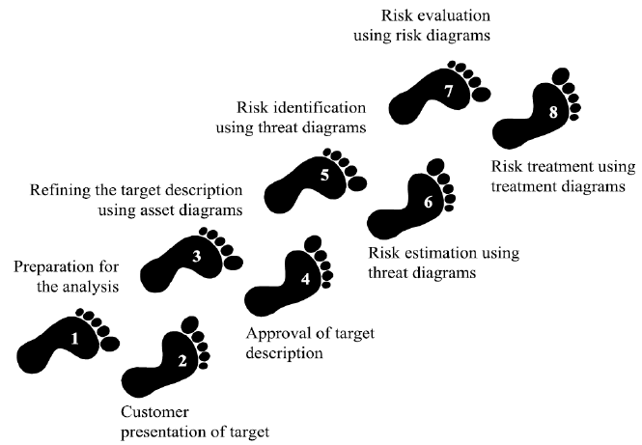
CORAS Process
Treat risk
Assess risk
Identify context

Slide 5
Step 3 Refining the target
Objective
  ensure a common understanding of the target analysis
Tasks
  The target as understood by the risk analysts is presented
  Identify the parties and assets
  Conduct a high-level analysis
Artifacts
  Asset diagram
  High-level analysis: preliminary list of Unwanted incidents

Slide 6




Asset Diagram
<name>
<name>
<name>
<name>
<name>

Slide 7



High level Risk analysis
Preliminary list of Unwanted Incidents
Who/ What is the cause? | How? What may happen? What does it harm? | What makes this possible?
… | … | …..
…. | …. | …..
Notes:
Undergraduate programme in Computer sciences

Slide 8
Step 4 Approval of the target
Objective
  decide a ranking of the assets; establish scales for estimating risks and criteria for evaluate risks
Tasks
  Define Likelihood scale and its description
  Define Consequence scale for each direct asset
  Agree on Risk evaluation criteria
Artifacts
  Likelihood and Consequence scales
  Risk function and Risk evaluation criteria
Notes:
Undergraduate programme in Computer sciences

Slide 9
Define Likelihood scale
Likelihood: the frequency or probability of something to occur
Likelihood | Description
Certain | Five times or more per year
Likely | Two to five times per year
Possible | Once a year
Unlikely | Less than once per year
Rare | Less than once per ten years
Notes:
Undergraduate programme in Computer sciences

Slide 10
Define Consequence scale
Asset Name
Consequence | Description
Catastrophic
Serious
Moderate
Minor
Insignificant
Notes:
For each asset identify the consequence scale
Undergraduate programme in Computer sciences

Slide 11
Risk Evaluation Matrix
Risk Function (Asset)
Consequence/ Likelihood | Insignificant | Minor | Moderate | Serious | Catastrophic
Rare
Unlikely
Possible
Likely
Certain
 | Acceptable
 | Monitor
 | Need to be treated
Notes:
For each asset identify the risk evaluation matrix
Undergraduate programme in Computer sciences

Slide 12
Step 5 Risk Identification
Objective
  Identify unwanted incidents, threats, threat scenarios and vulnerabilities
Tasks
  Identify Assets and Threats
  Identify Unwanted Incidents
  Identify Threat Scenarios
  Identify Vulnerabilities
Artifacts
  Threat diagram
Notes:
Undergraduate programme in Computer sciences

Slide 13
Threat Diagrams
Create your threat diagrams in the following slides, one diagram per slide
  Each diagram should be about one "topic" or "issue"
  For example, one diagram can address e.g. one asset, one particular kind of threat, one particular part of the target, etc.
Complete first the risk identification, i.e. create all diagrams without considering likelihoods and consequences
Once the risk identification is completed, use the diagrams to proceed with the risk analysis
The next slide gives a skeleton that can be used as a starting point

Slide 14






<description>
<name>
<description>
<description>
<description>
<name>
<name>
<description>
<description>
<description>
<name>
<description>
<name>
<name>

Slide 15
Possible Threats
Flooding
Fire
Thief
Trusted neighbour
Daughter

Slide 16
Step 6 Risk estimation
Objective
  determine level of the identified risks
Tasks
  Assign likelihood estimated for each Threat Scenario
  Assign likelihood estimated for each Unwanted Incidents
  Assign consequence caused by each Unwanted Incidents on each Asset (the consequence is denoted on “impact” relation)
Artifacts
  Threat diagrams with likelihood and consequences assigned
Notes:
.
Undergraduate programme in Computer sciences

Slide 17
Copy the previous threat diagrams here and add the values for likelihood and consequence

Slide 18
Step 7 Risk evaluation
Objective
  Identify acceptable risks and risks that have to be treated
Tasks
  Map the risks into the Risk Function (from step 4)
  Evaluate which risks are acceptable and which are not
  Summarize the risk picture by Risk Diagram
Artifacts
  Completed Risk Function
  Risk Diagram with evaluation result
Notes:
Party: An organization, company, person, group or other body on whose behalf a risk analysis is conducted
Undergraduate programme in Computer sciences

Slide 19
Risk Evaluation Matrix
For each direct asset
  Copy the risk evaluation matrix
  Plot the values of the likelihood and consequence into the risk evaluation matrix
Notes:
Plot the values of the likelihood and consequence into the risk evaluation matrix
Undergraduate programme in Computer sciences

Slide 20





Risk Diagram
<ID: description>
<name>
<name>
<ID: description>
<name>
<name>
<ID: description>
<name>
<name>

Slide 21
Step 8 Risk treatment
Objective
  identify cost effective treatments for the unacceptable risks
Task
  Identify Treatment Scenario for unacceptable risks
  Create Treatment diagram
  Summarize by Treatment Overview diagram
  Estimate the cost-benefit of each treatment
Artifacts
  Treatment diagram (Threat diagram with Treatment added)
Notes:
Find means to reduce their likelihood and/or consequence.
Undergraduate programme in Computer sciences

Slide 22
Treatment Diagrams
Create your treatment diagrams in the following slide
  How: Copy-and-past the threat diagrams from step 6 and document treatments by annotating these diagrams
Create your treatment overview diagrams in the following slides
  How: Copy-and-past the risk diagrams from step 7 and document treatments by annotating these diagrams

Slide 23
Possible Treatments
Fences
Barriers
Monitoring/Detection Systems
CCTV cameras
Water and Fire Protection
Insurance
Strong password for the locker

Slide 24
Treatment Diagram

Slide 25
Treatment Overview Diagram

Slide 26
Treatment Evaluation
Estimate the cost-benefit of each treatment and decide which ones to implement
Treatment | Cost | Risk | Risk reduction | Select to implement
…. | … | … | … | …
… | … | … | … | …
… | … | … | … | …

